Slide 1


powered by
Month # -
Month #,
2017
Camp Location City and State
“Today in the midst of the many shooting stars in the world,
follow the bright star of Jesus!”
– Pope Francis

Slide 2

Month # - Month #, 2017
BEST CITY, STATE
LOCATION OF OUR CAMP
Find out more about Challenge camps across the US & Canada: challengeyouthministry.com/camps
WHY CHOOSE A CHALLENGE CAMP?
Campers will participate in activities to strengthen their bonds of friendship and make new ones! They will enjoy prayer and spiritual growth through participation in Mass and spiritual mentoring. Confession will be available. Sports, games, workshops, team dynamics, exciting night activities, swimming and fun in the sun, (add in specifics about other highlights and camp activities you will be offering, mention any outings or sightseeing that will be included as well as extra activities such as boating, tubing, horseback riding, etc )
THIS SUMMER’S THEME: CONNECT
Connect with God, the Church, yourself and others! Life is a constellation of connections and relationships. At camp, every day we will focus on one of these important connections & relationships, delving deeper in how to be a Christian in the world today who prays, is confident, kind to others and who loves the Church.
ALL ABOUT CAMP
DATES: Month day-Month day , 2017
AGES: Girls rising to 5th – 12th grade
COST: $375 (includes camp T Shirt, water bottle & notebook as well as 5 days of lodging & meals)
LOCATION: Name of Camp Location City, State
www.websiteofcamplocation.com

Slide 3

Date our camp is taking place.
BEST CITY IN THE COUNTRY, STATE
LOCATION OF OUR CAMP
ABOUT CHALLENGE
Challenge is a network of clubs for girls ages 10-18, to get know more about Christ and their catholic faith, and work to better the world around them. Challenge is team based, teen led, service driven, and with a virtue centered curriculum. Challenge does this through regular team activities, service projects , retreats and camps. Challenge can be found in parishes and schools across the US and Canada. Find out more at www.challengeyouthministry.com Challenge is powered by
OUR CAMP STAFF
Our camp staff is made up of a wonderful team of teen camp counselors and JR counselors (ages 14 & up) as well as adult volunteers. Campers will be led by our camp counselors and supervised by our camp adult volunteers.
TO REGISTER
Please send the registration form along with the Permission Form and payment of $123 made out to Name to: Mailing Address Mailing Address Registration deadline is Date Day, Year.
QUESTIONS
Contact Name Last Name
123-456-7891
Email@email.org
www.campweb.com

Slide 4
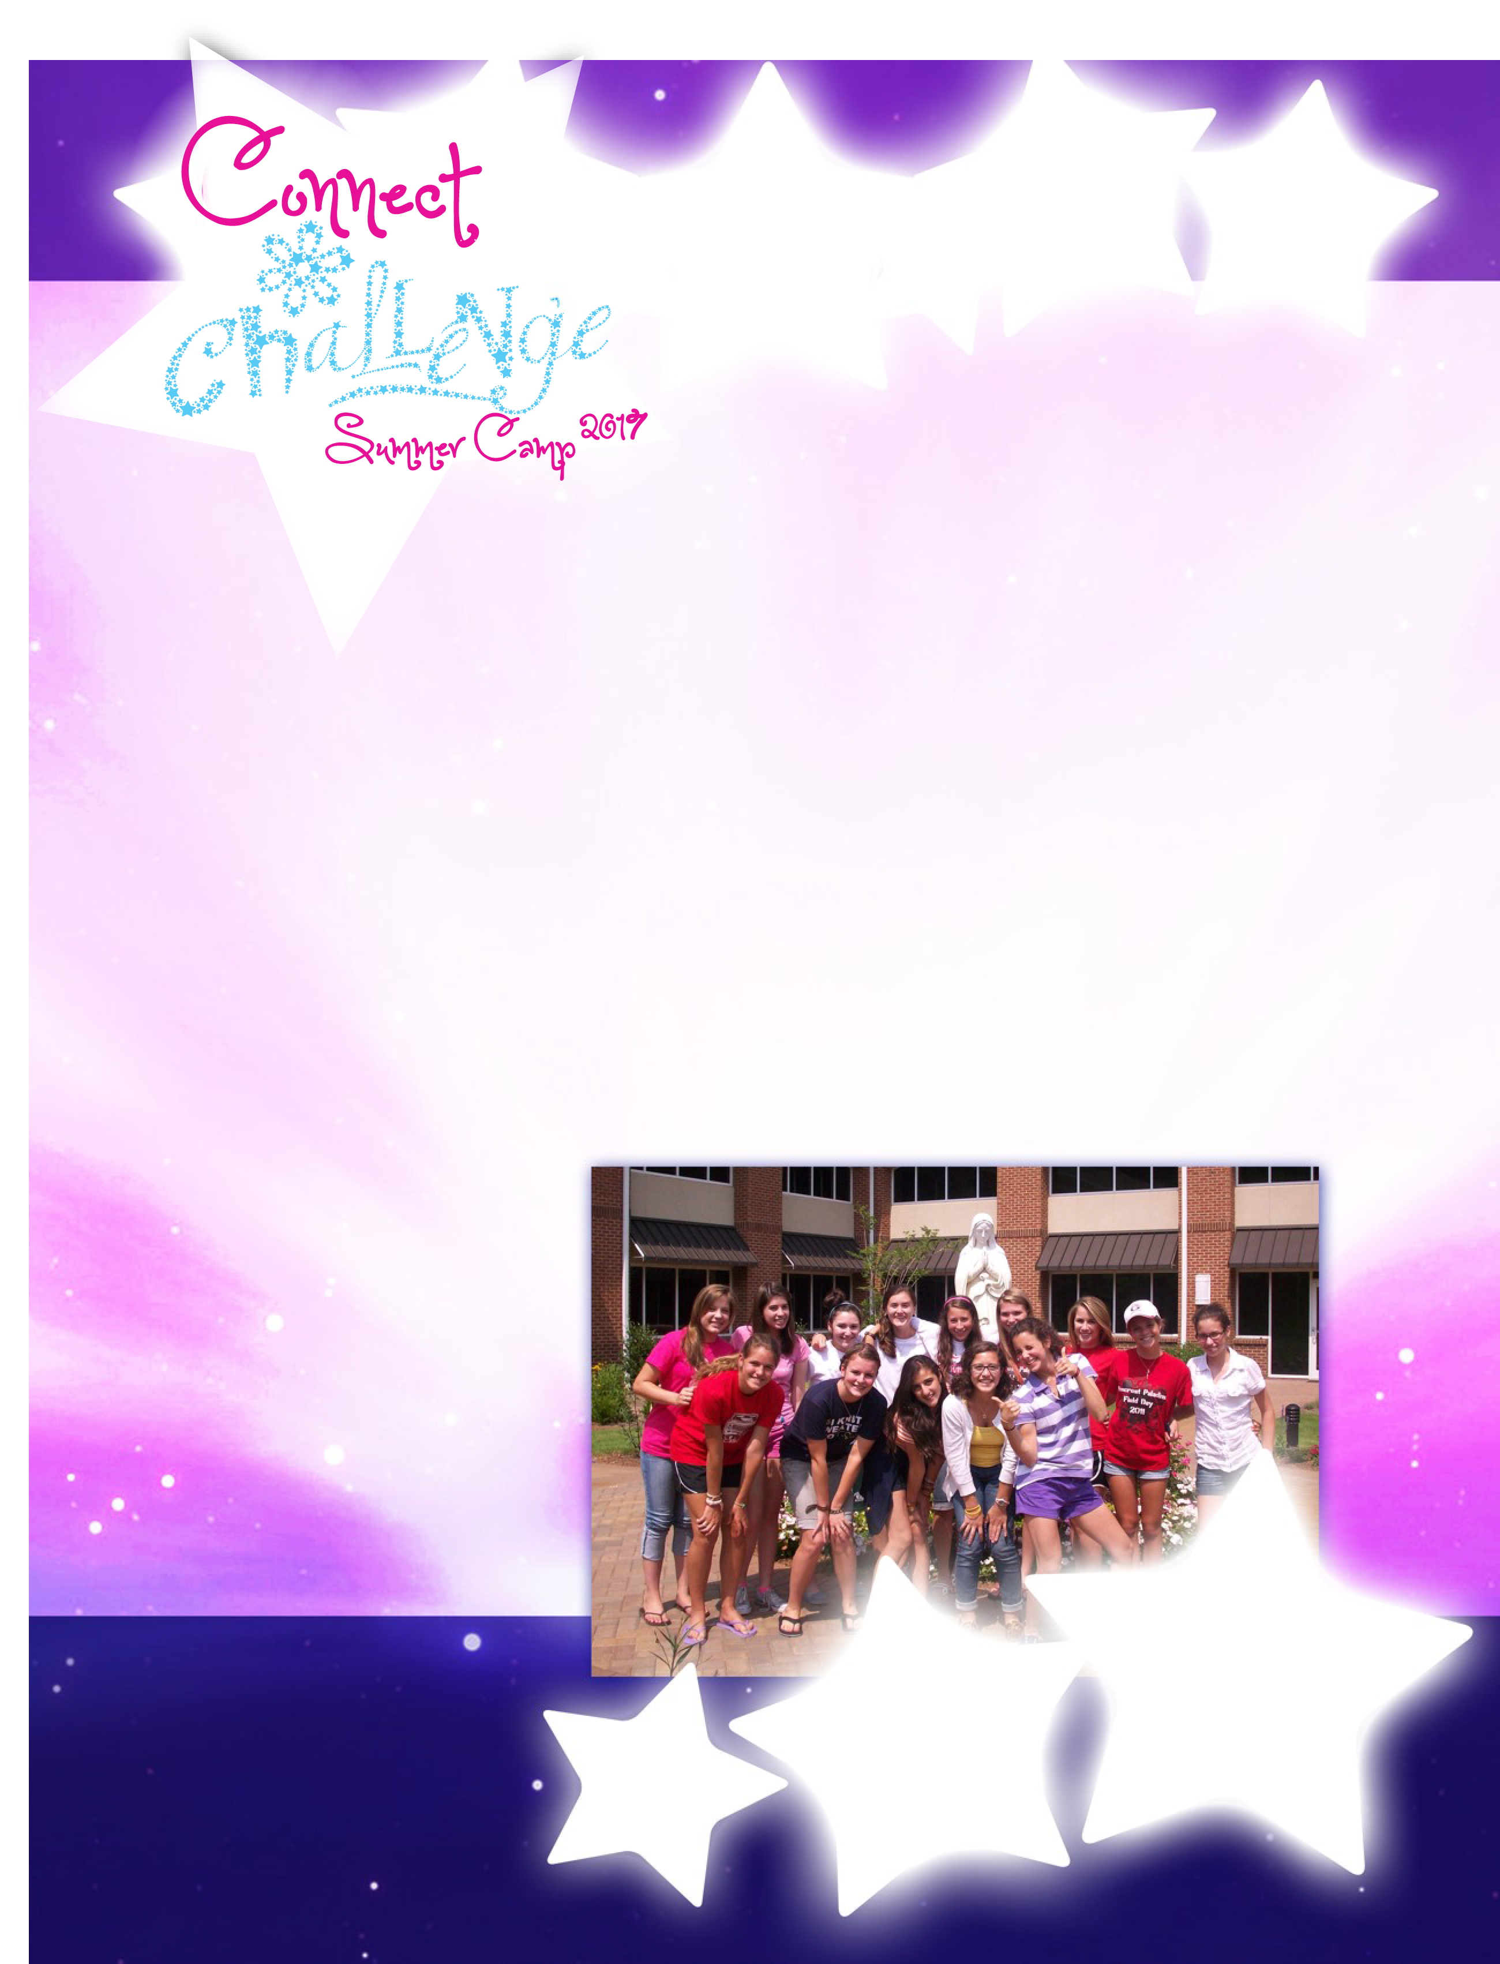
REGISTRATION FORM
Camper’s First & Last Name:____________________________________________________________________________
Campers Age: ________ Date of Birth: _____________________ Grade Completed: …….… School:____________________
Parent’s First & Last Names: ___________________________________________________________________________
Home Address: ______________________________________________________________________________________
Parent’s Phone- Home: …..…..……………………………………… Cell:………………………………………………………..
Parent’s Email: _________________________________________________________________________________
T -Shirt Size: □YS □YM □YL □AS □ AM □AL □ AXL
□ Please order an additional t-shirt for my daughter at $10
□ Contact me about volunteer opportunities in preparation or during the camp.
CAMP PACKING LIST
___ Shorts enough for each day
___ Shirts enough for each day ___ 2 pairs of jeans
___ 1 raincoat with hat or hood
___ 1-2 sweatshirts, sweaters or jackets
___ Underwear and socks ___ Flip flops or sandals
___ Bathing suits (one-piece suits or tankini’s )
___ 2 nice outfits for Mass
___ Tennis shoes for playing sports
___ Water shoes ___ Shoes for hiking
___ Soap and shampoo, hairbrush
___ Toothbrush and toothpaste ___ Pajamas
___ Sunscreen and Bug repellant ___ Hat
___ Pillow and sleeping bag ___ Laundry bag
___ 2-3 Towels and washcloths
___ Bible, rosary,
Registration Deadline:
May 20, 2017
Check out our camp website:
www.yourwesbite.com
Camp Dates
2017
powered by

